Slide 1


Prevention Airline Crash due to Birds Strike using Machine Learning
​

Slide 2
Team Members
Keerthi Alekya Muppuri
Mallika Maamidi
Haritha Sri Batchu
700741949
700746126
700742314

Slide 3
Roles/Responsibilities
KEERTHI ALEKYA
MALLIKA
HARITHA
Primarily responsible for analyzing, implementing, and developing the Support Vector Machine (SVM) algorithm utilized in this project. Keerthi examined the details of these algorithms, and optimizing their hyperparameters to increase the accuracy of predictions.
Keerthi analyzed the accuracy of these models in forecasting airplane disasters brought on by bird attacks via extensive research and testing.
Keerthi also played a significant part in documenting the whole process, including the implementation specifics and results.
Primarily responsible for implementing KNN and naïve bayes methods and conducted extensive research and produced a detailed report outlining each aspect of the project, demonstrating an in-depth knowledge of the goals and procedures involved in utilizing machine learning to anticipate aviation disasters caused by bird attacks.
Mallika made an important impact by emphasizing dataset analysis and preparation. This required a variety of tasks, including gathering and analyzing important details about bird strikes and airplane crashes, cleaning and normalizing the data, and implementing methods like label encoder, KNN clasifier,Naive Bayes classifier and Matlplot library for data visualization
Primarily responsible for implementing decision tree algorithm which is used in our project.
Haritha was crucial in carrying out the final review of all the models created for the project. This entailed assessing the performance of several machine learning models on the dataset.
Haritha additionally conducted an intrinsic error analysis to detect and comprehend the models' limitations and problems. Based on the evaluation findings , played a major role in selecting the best-performing model for forecasting airplane disasters caused by bird strikes Based on these results, several preventive measures can be implemented to reduce the occurrence and impact of bird strikes

Slide 4

Motivation
The critical need to improve aircraft safety and reduce the hazards of bird strikes is our primary motivation.
Machine learning algorithms can offer real-time insights on bird behavior, flight patterns, and environmental factors that affect bird attacks by utilizing the capabilities of data analysis, pattern recognition, and predictive modeling.
The creation and use of machine learning algorithms for preventing bird strikes are in line with the general aviation sector's trend of utilizing artificial intelligence and cutting-edge technology.
The aviation sector may get closer to eliminating bird attacks and assuring safer skies for everybody by utilizing the power of machine learning.

Slide 5
Objectives
The main objective of using machine learning algorithms to avoid aircraft disasters caused by bird strikes is to improve aviation safety by successfully minimizing the hazards associated with bird strikes.
Proactive risk assessment
Early warning systems
Optimal flight path planning
Deterrence techniques
Improved situational awareness
Enhanced data-driven decision-making

Slide 6
Related work
Support Vector Machines: SVM functions by locating an ideal hyperplane based on pertinent information that maximum separates the two groups, "crash" and "no crash."
KNN(K-Nearest Neighbour: To create predictions, it locates the k-nearest neighbors of a new instance and makes use of their results.
Naïve Bayes: Given the presence of specified parameters like bird population density, flying altitude, and weather conditions, Naive Bayes calculates the probability of a crash by comparing the probabilities for several classes.
Decision Tree: Decision trees are useful tools for studying incidents involving bird strikes.

Slide 7
Problem statement
The aviation sector has a major challenge in preventing airline disasters caused by bird attacks, necessitating the development of effective techniques. Bird strikes cannot be effectively predicted or prevented using conventional methods, and the growing number of air traffic makes the issue worse. The goal of this study is to investigate how machine learning algorithms might improve bird strike prevention. Creating proactive and data-driven solutions that can analyze real-time data on bird behavior, flight patterns, and environmental factors in order to identify high-risk situations, improve situational awareness, and enable timely preventive measures, ultimately ensuring safer skies and reducing the risks associated with bird strikes, is the main challenge.

Slide 8
Proposed solution
Machine learning algorithms can be used in a systematic approach to prevent airplane disasters caused by bird strikes. The phases that make up the solution to this issue are as follows:
Data collection
Feature extraction
Labelling
Model building
Analysis
By lowering the dangers associated with bird strikes and guaranteeing safer skies for everyone, this approach will ultimately help to improve the overall safety and security of airline operations.

Slide 9
Results
ALGORITHMS​ | ACCURACY %​
SVM​ | 85.3%​
DECISION TREE​ | 79.67 %​
KNN​ | 99.6%​
NAÏVE BAYES​ | 42.8%​
​
These accuracy percentages indicate the performance of each algorithm on a particular task or dataset.
The higher the accuracy, the better the algorithm is at making correct predictions.​
Based on these results, it is observed that the KNN model achieved the highest accuracy (0.9956) among the four algorithms, indicating its effectiveness in predicting bird strikes.​
​
​
​

Slide 10
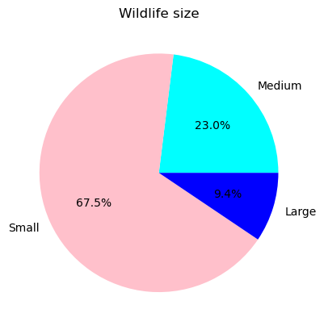
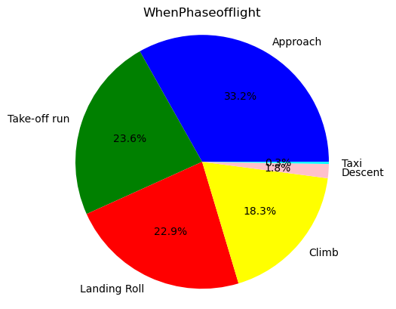
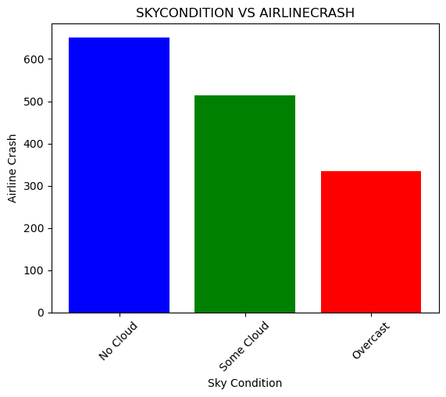
Airline Crash due to different condition
Airline crash VS wildlife size
Airline crash VS Sky Condition
Airline crash vs Phase of flight

Slide 11
Prevention Of Airline Crash due to bird strike
1.Install bird deterrent devices that work in a variety of cloud circumstances. Visual deterrents, such as scarecrows or bird-shaped devices, as well as acoustic devices that generate noises to dissuade birds from entering airport areas, are examples of such measures.
2. Provide extensive instruction to pilots on bird strike avoidance and proper reactions during bird strike situations. This involves teaching pilots about bird behaviour, typical bird strike regions, and measures for reducing the danger of bird strikes during take-off, landing, and low-altitude flights.
3.Implement bird detection technology, such as radar or acoustic monitoring, to locate and track birds in and around airports during important flight phases. This can assist pilots and air traffic control workers in anticipating and responding to possible bird strike threats.

Slide 12
References
Dykbayir, H. S., &amp; Bulbul, H. I. (2018). Estimating the Effect of Structural Damage on the Flight by Using Machine Learning. 2018 17th IEEE International Conference on Machine Learning and Applications (ICMLA). doi:10.1109/icmla.2018.00216 R.Nicole, “Title of paper with the only first word capitalized,” J. Name Stand. Abbrev., in press.
https://openaccess.thecvf.com/content/ACCV2022/papers/Sun_AirBirds_A_Large-scale_Challenging_Dataset_for_Bird_Strike_Prevention_in_ACCV_2022_paper.pdf
Zhou D., Zhuang X., Zuo H., Wang H., Yan H. Deep Learning-Based Approach for Civil Aircraft Hazard Identification and Prediction. IEEE Access. 2020;8:103665–103683. doi: 10.1109/ACCESS.2020.2997371.

